Slide 1

Team 31 – GFRJ ATOM III

Slide 2
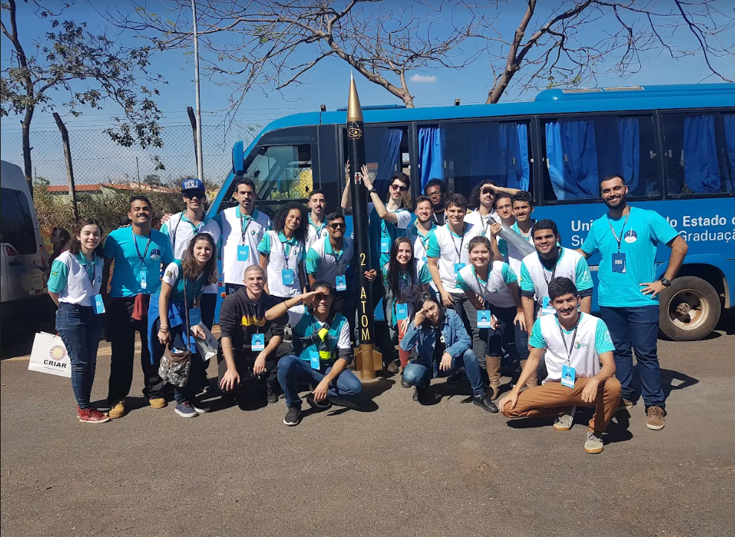
Who are we?
Grupo de Foguetes do Rio de Janeiro (GFRJ)
State University of the State of Rio de Janeiro
Since: 2016
Total number of Members: 41
Figure 1: Team in LASC 2019

Slide 3
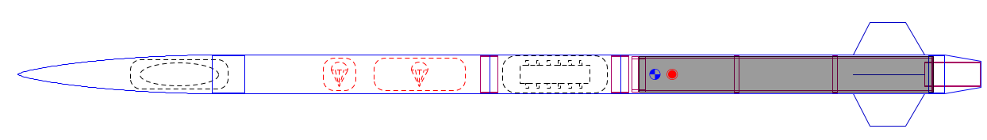
Mission Armstrong
Rocket: ATOM III
Apogee: 3 km
Propulsion: Solid Motor
Innovation: Structures and Recovery

Slide 4
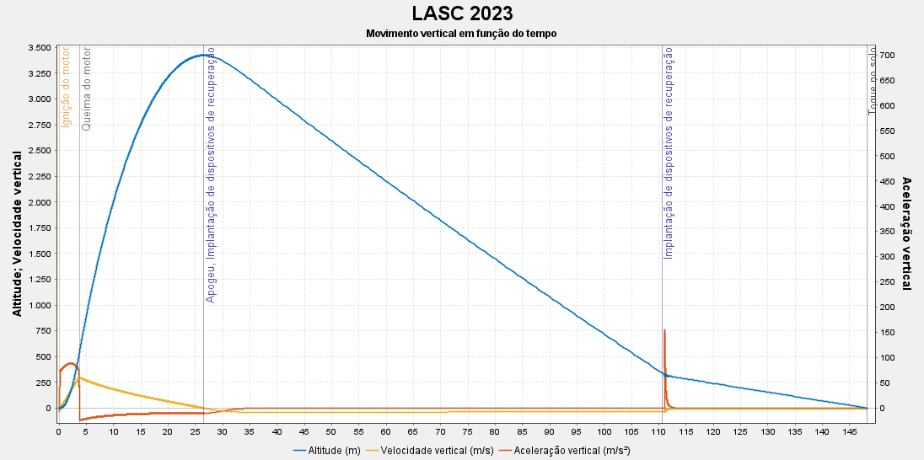

Mission Performance
Flight data
Maximum speed | 296 m/s
Maximum acceleration | 9 G
Altitude predictions | 3424 m
Figure 3: Flight profile simulations

Slide 5

Mission Performance
Component masses
Vehicle weight | 30 kg
Propellant weight (all) | 7,6 kg
Payload weight | 4 kg

Slide 6
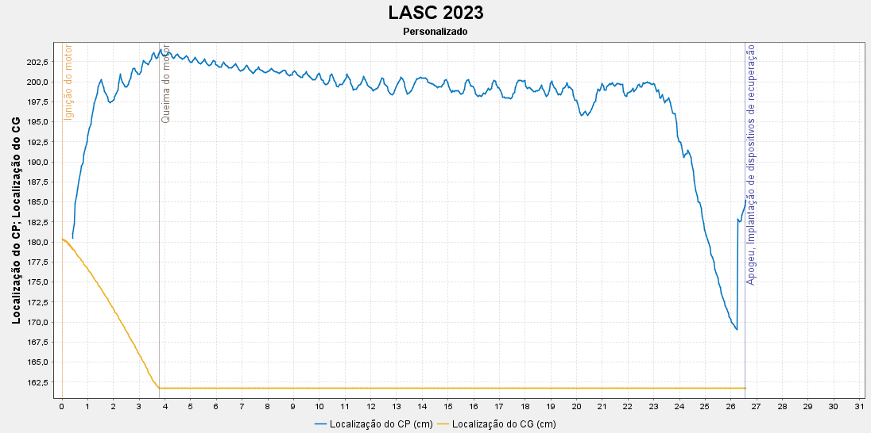

Mission Performance
In the dynamic simulation, the determination of the centers of pressure and of gravity varies with time.
Position of the centers of pressure and gravity in static simulation (from nosecone tip)
Center of Pressure | 200.3 cm
Center of Gravity | 180.4 cm
Stability margin: 1.67
Figure 4: Simulated center of pressure and simulated center of gravity

Slide 7
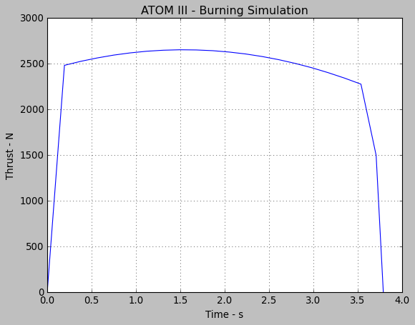
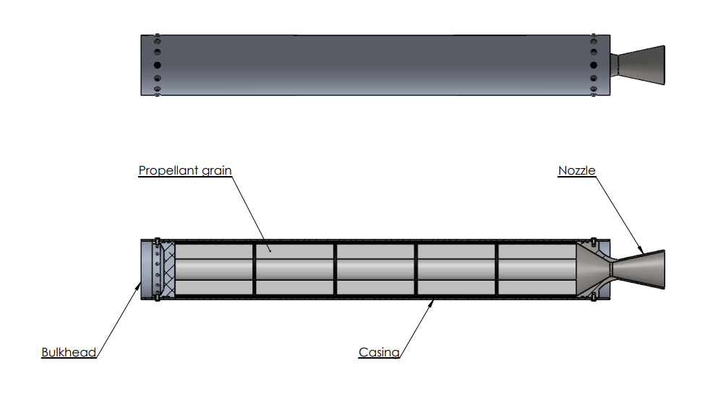
Propulsion Design
Type: SRAD Solid
Letter Class: M
Total Impulse: 9,384.4 N⋅s
Figure 5: Simulated motor thrust curve

Slide 8
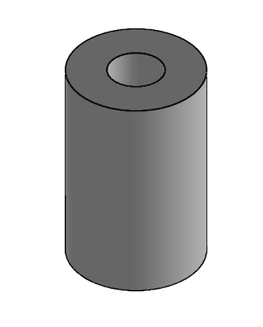
Propulsion Design
Engine dimensions
Engine length | 1004.81 mm
Engine diameter | 114.3 mm
Casing thickness | 3.18 mm
Nozzle length | 169.8 mm
Figure 6: Motor Design
Propellant: mixture of potassium nitrate with Sorbitol (KNSB)
Figure 7: Propellant Grain

Slide 9
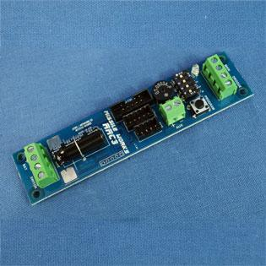
Avionics and Recovery Design
The data aquisition subsystem acquires altitude, velocity, acceleration (3-axis), magnectic field (3-axis), position (3-axis), temperature, GPS (2-axis).
All this data that was just listed is acquired thanks to
- GY-87 module
- Neo-6m module
Figure 8: COTS Altimeter RRC3

Slide 10
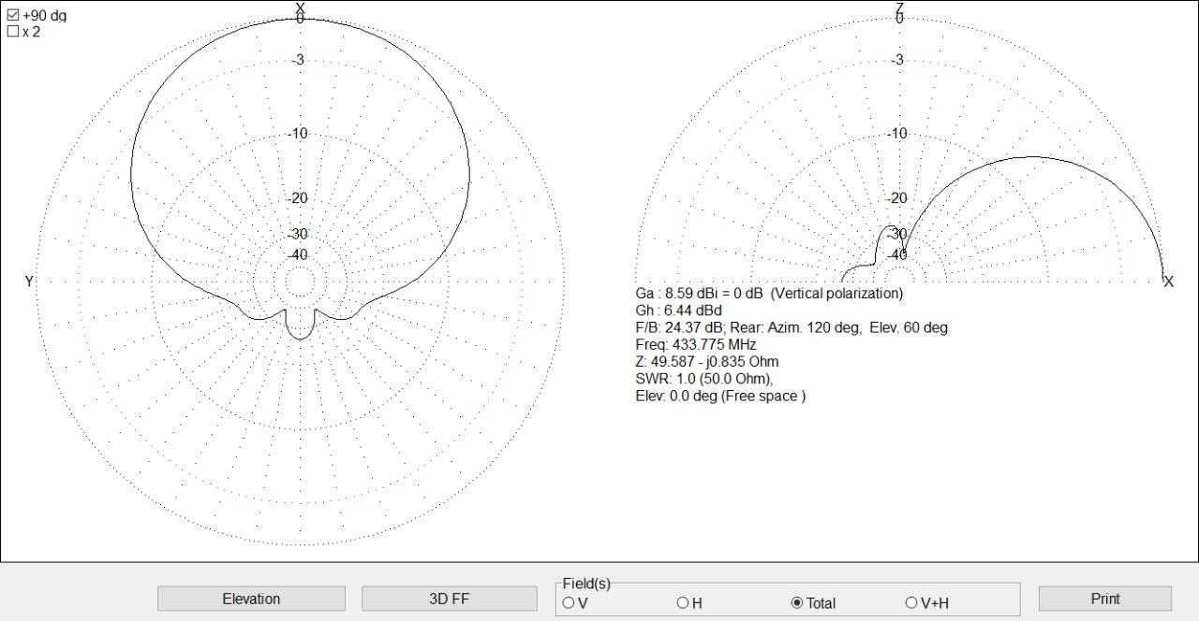
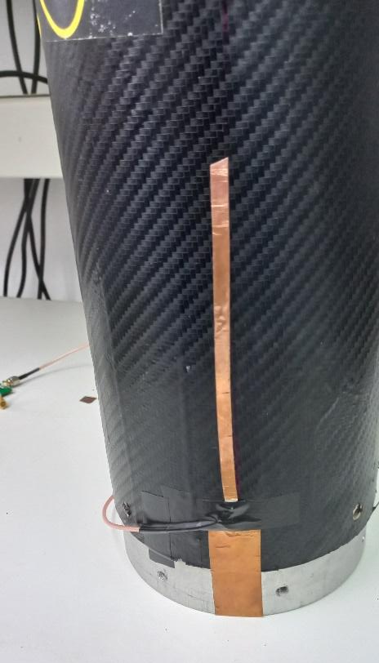
Avionics and Recovery Design
Figure 9: Base Antenna Radiation Diagram
Figure 10: Rocket Microstrip Antenna

Slide 11
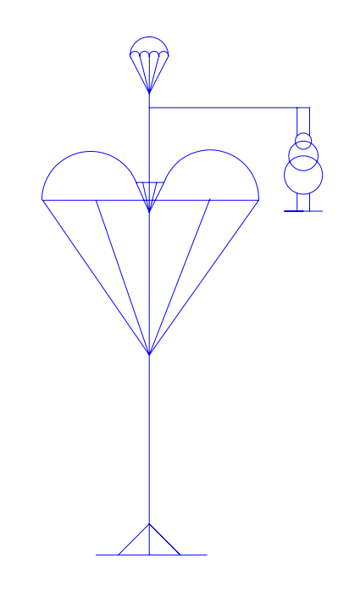
Avionics and Recovery Design
The recovery system consists of CO2 tank, three ring system, two parachutes (drogue and main).
Fall Speed
Drogue Stage | 30 m/s
Main Stage | 9 m/s
Figure 11: Recovery System Diagram

Slide 12

Vehycle Structure
Figure 12: ATOM III Structure
Vehicle dimensions
Total vehicle length | 304.5 cm
Airframe diameter | 119 mm
Fin-span | 120 mm
Fuselage Material: fiberglass

Slide 13
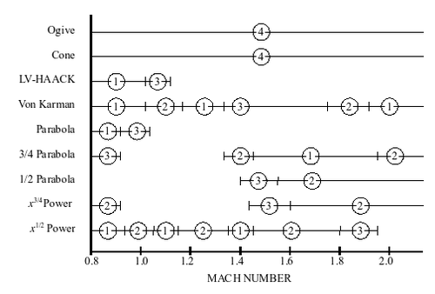
Vehycle Structure: Von Karman Nose Cone
Figure 13: Mach Number

Slide 14
DESENHO DA LAURA

Slide 15

Thank you!

